Slide 1
Top 50 Companies analysis
Top 50 Companies

Slide 2
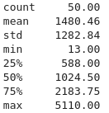
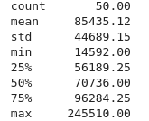
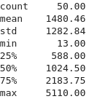
Financial Info(in millions $):
Total assets stats
Revenue stats
Net income stats

Slide 3
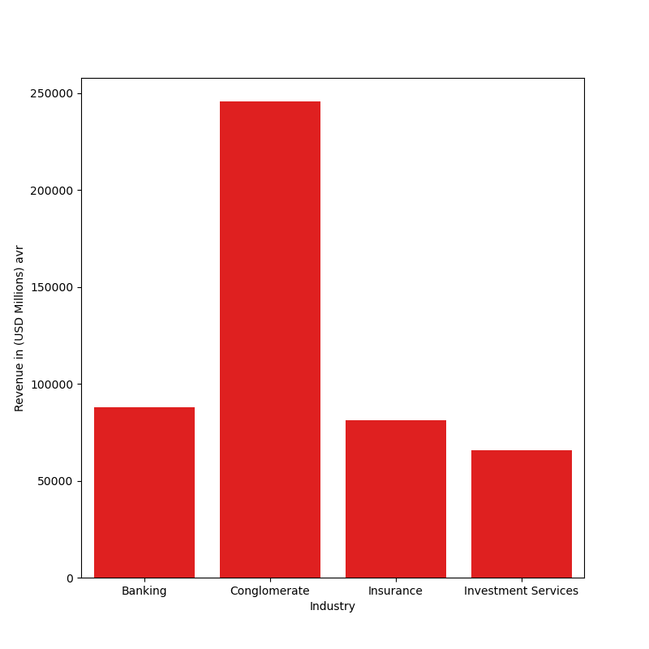
This graph is used to measure the revenue each industry has made.
We can see that the conglomerate section dominated the charts

Slide 4
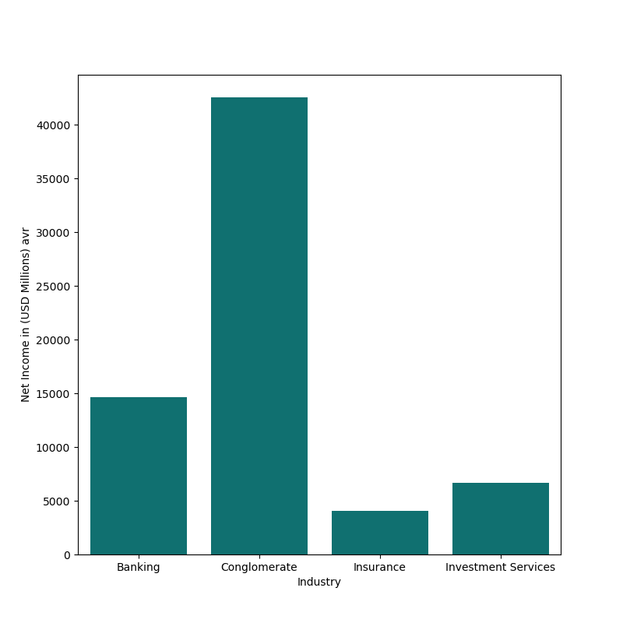
This graph shows the average industries net income
From the graph we can easily see that even combined, all the other industries cant compare to the earnings of the conglomerate

Slide 5
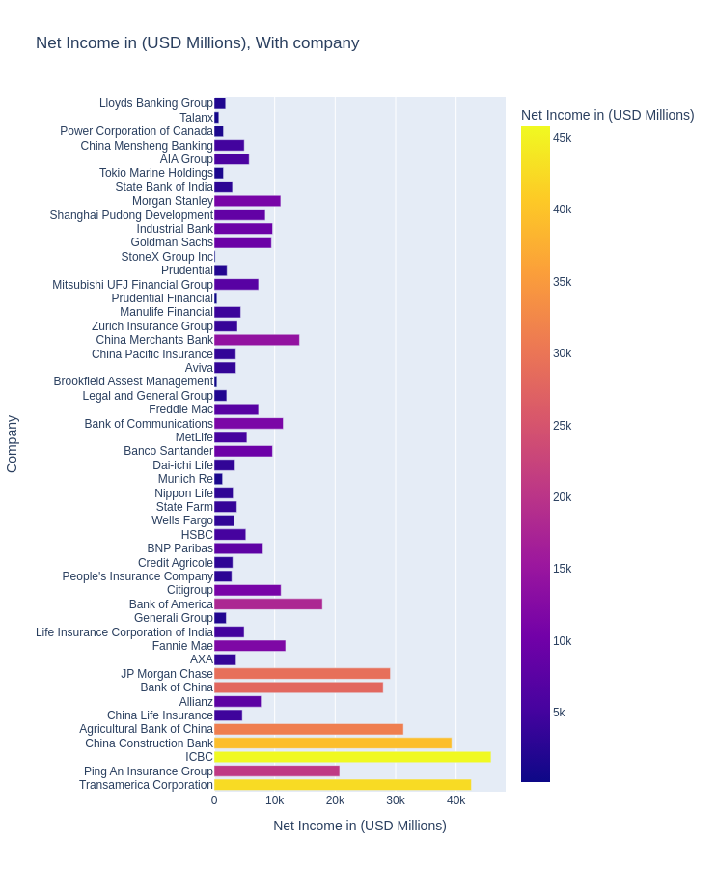

Slide 6
As we can see in the above graph, the Transamerican corparation and the ICBC are the two companies with the largest net income, while StoneX Group inc and Brookfield Assets Managment had the lowest

Slide 7
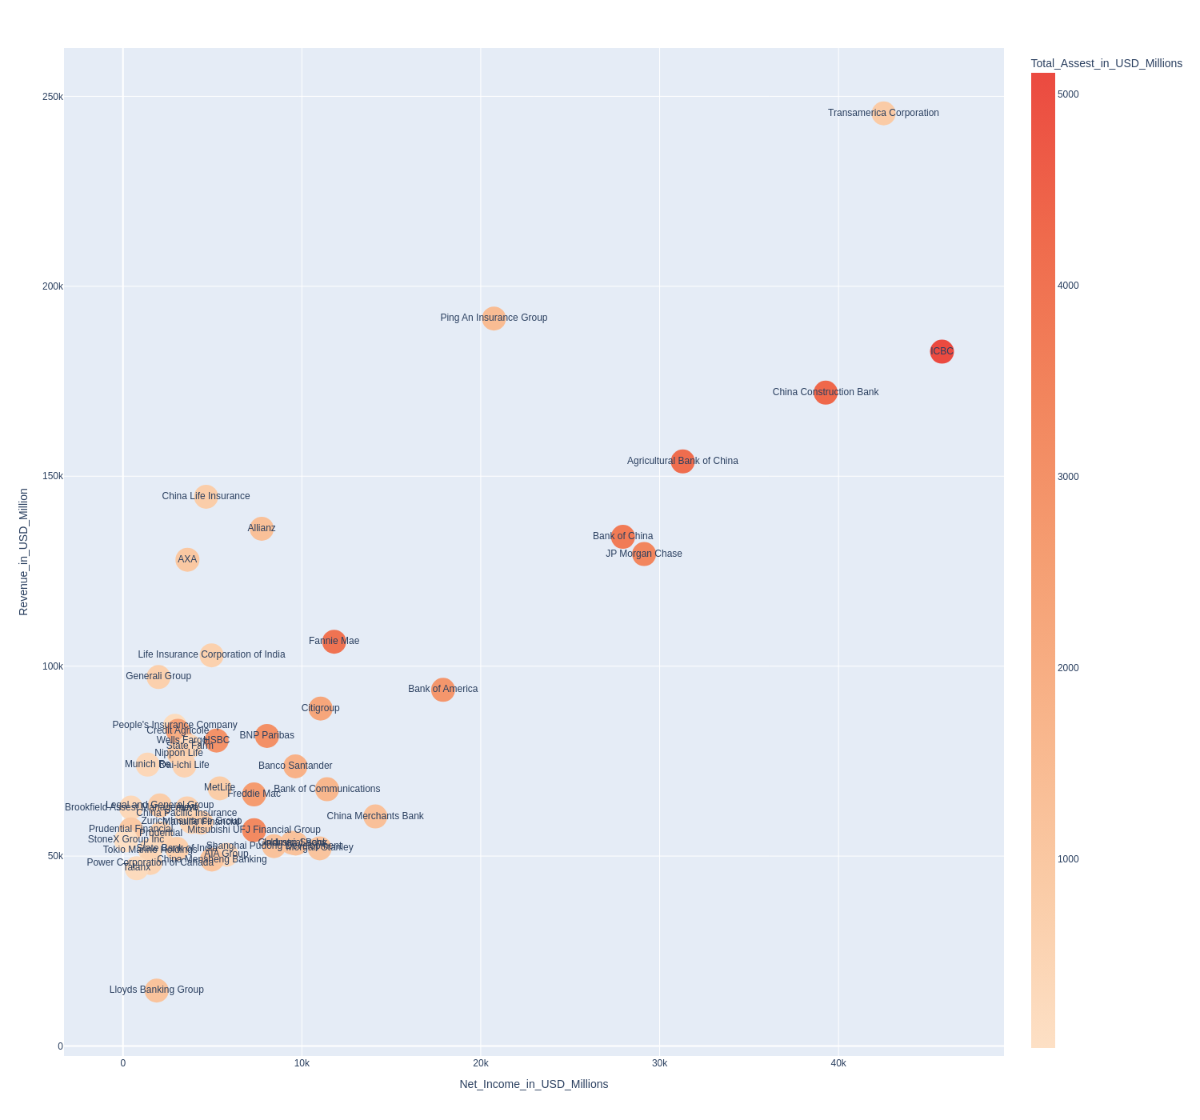
Scatter Plot

Slide 8
As we can see in the above scatter plot, although ICBC has more net income and total assets, the Transamerican Corparation hase more total revanue.

Slide 9
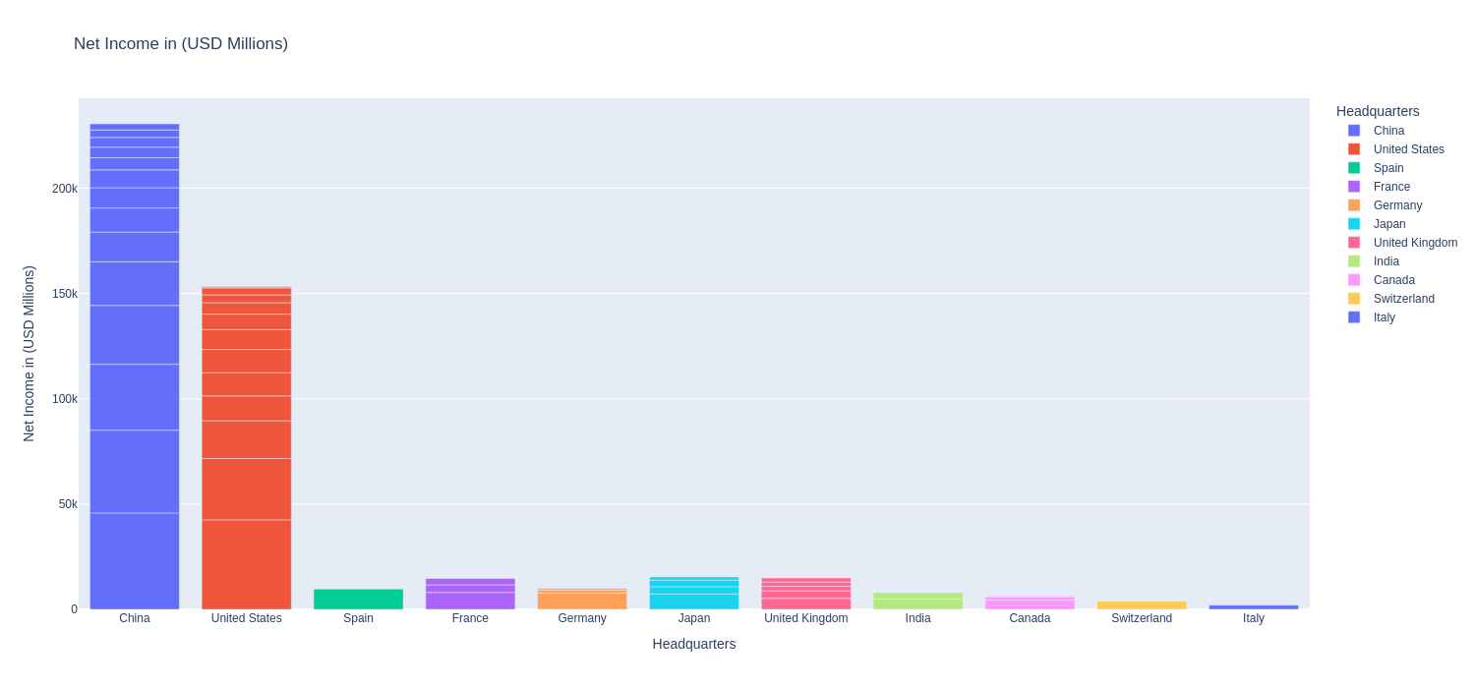

Slide 10
The net income bar graph above, displays the countries with not only the most companies in the Top 50, but also the collective income of all the companies pooled into their respective countries

Slide 11
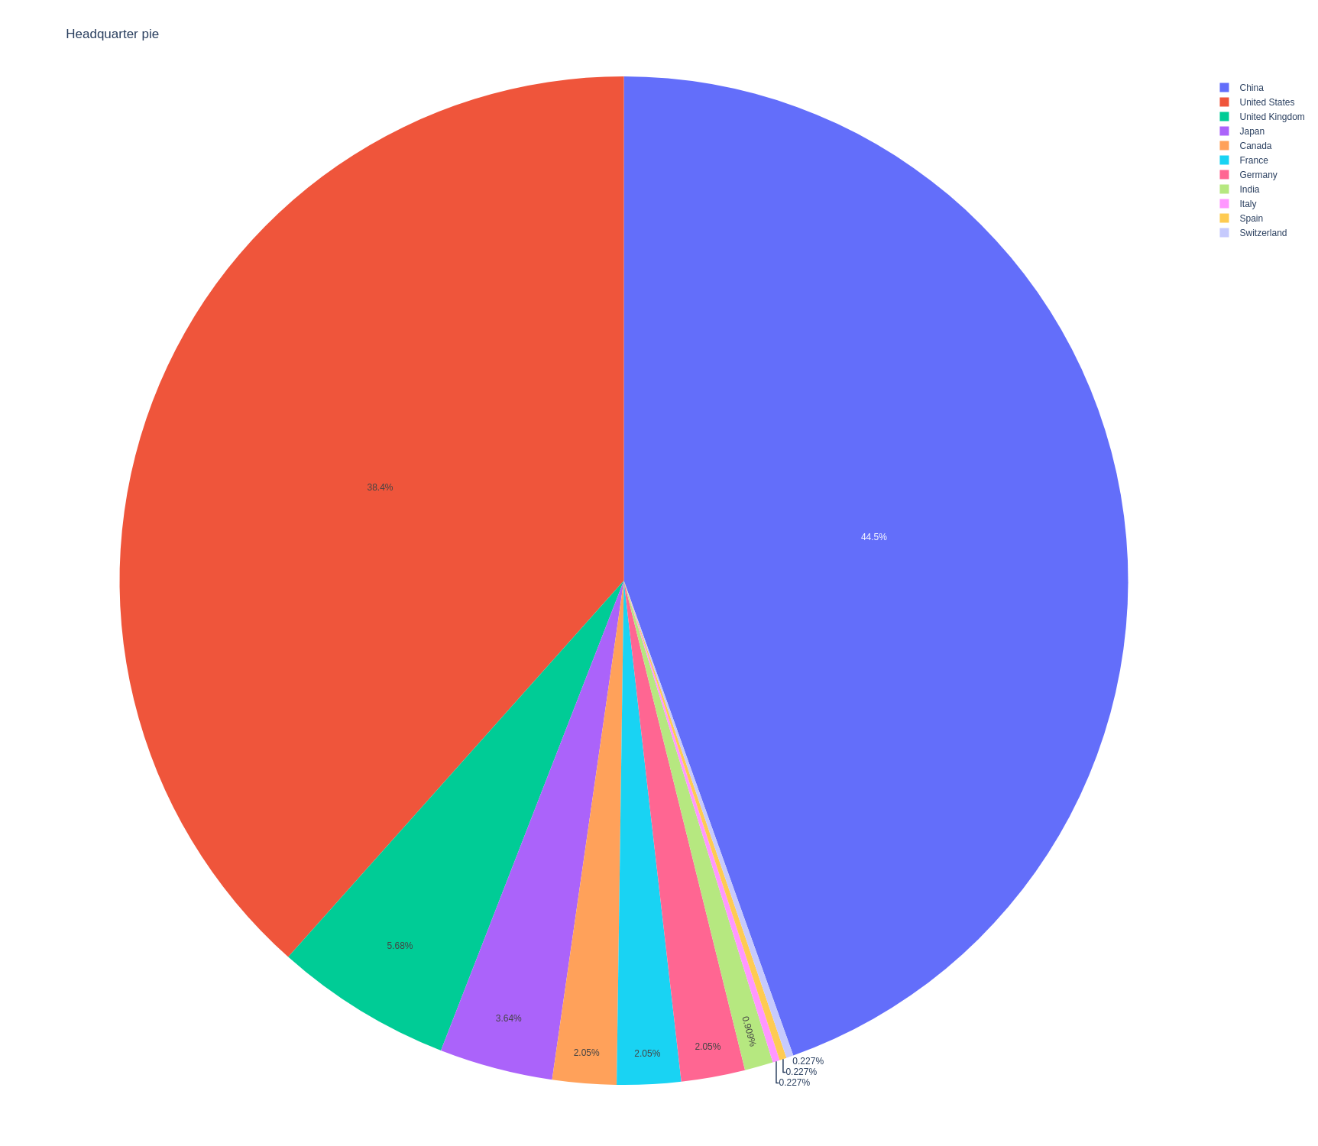

Slide 12
The above pie chart gives us another look at the amount of Top 50 companies are pooled into different countries.

Slide 13
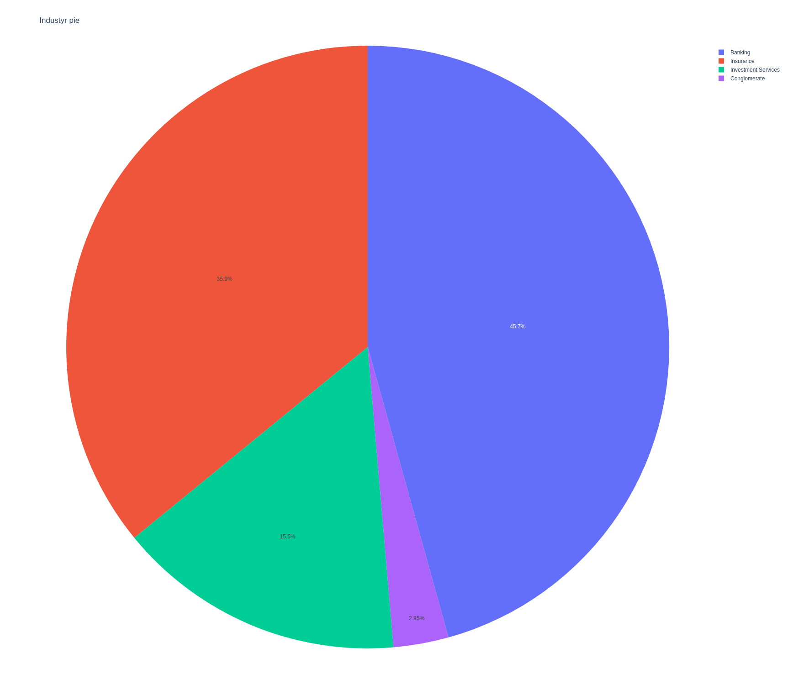

Slide 14
The above pie shows us the industry split in the Top 50 Companies. What you may find interesting is that conglomerate category is the smallest. There was in fact only one conglomerate and it had the highest rank.

